Slide 1

The influence of various factors on the spread of COVID-19
By Helena Fedorenko, Xing Ying Chen, Kevin Guillemette and Brecht Nys

Slide 2




The factors that we have considered…
Climate
Government Response
Vaccination Rate
Air Quality
Countries with higher average temperatures or higher levels of humidity exhibit increased numbers of COVID-19 cases.
Extended periods of school- and workplace closing, and international travel restrictions, have lead to a lower spread of COVID-19 cases.
Higher vaccination rates result in lower reproduction rates and lower death rates.
Areas with poor air quality have shown higher rates of COVID-19 cases.

Slide 3
Factor: Climate
Countries with higher average temperatures or higher levels of humidity exhibit increased numbers of COVID-19 cases.

Slide 4
Factor: Government Response
Extended periods of school- and workplace closing, and international travel restrictions, have lead to a lower spread of COVID-19 cases.

Slide 5
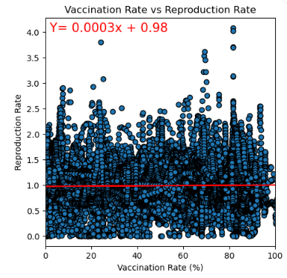
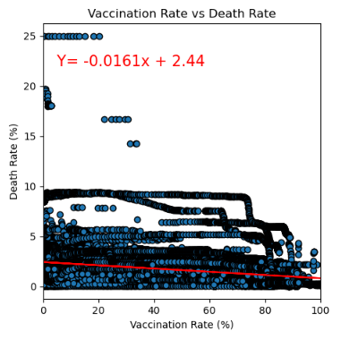
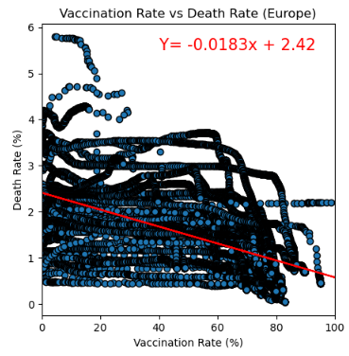
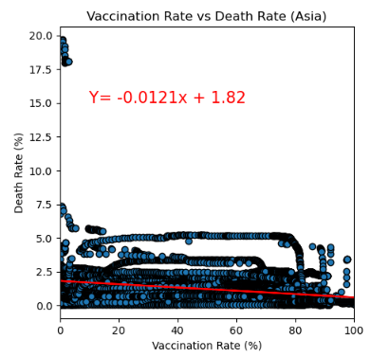
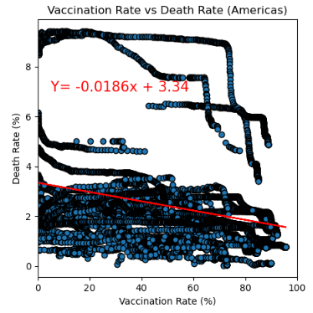
Factor: Vaccination Rate
Higher vaccination rates result in lower reproduction rates and lower death rates.
Variables
Reproduction rate: the average number of people that one infected person will pass the disease on;
Vaccination rate: proportion of country population that has received at least one vaccination;
Fully vaccinated rate: proportion of country population that has received both vaccination;
Death rate: proportion of infected people that died.
Dataset
Data on COVID cases and vaccination rate for all countries from Feb-2020 until Feb-2023;
Country name mapped to continent using RESTCOUNTRY API
Influence of vaccination rate on reproduction rate and death rate
Regional discrepancies
Outcome
xxxx

Slide 6
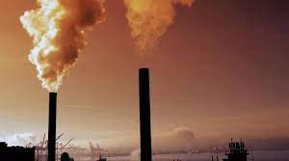
Factor: Air Quality
Hypothesis: Areas with poor air quality have shown higher rates of COVID-19 cases.
Variables:
Pollution Rank by Country: Rank of world most polluted countries
Confirmed Covid Rate: Covid cases divide by country population.
Death Rate: Total number of Covid death cases in each country divided by total confirmed Covid cases.
Recovered Rate: Total number of Covid recovered cases in each country divided by total confirmed Covid Cases in each Country.
Dataset:
Rank of world most polluted countries based on pollution rate from 2018 to 2021
Latest covid data set: accumulated data on all covid cases worldwide (from 2019-2021)

Slide 7
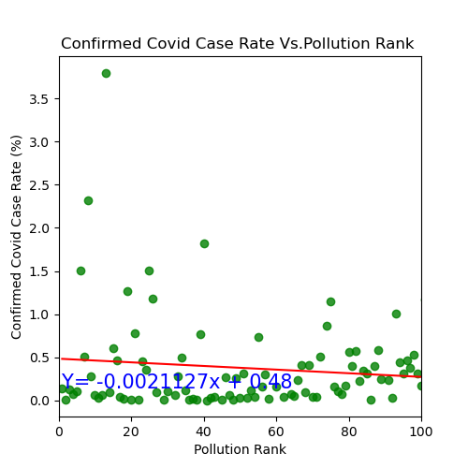
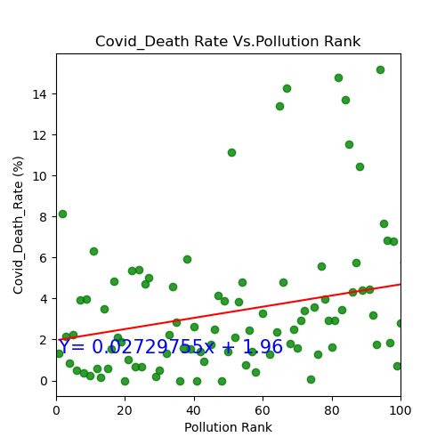
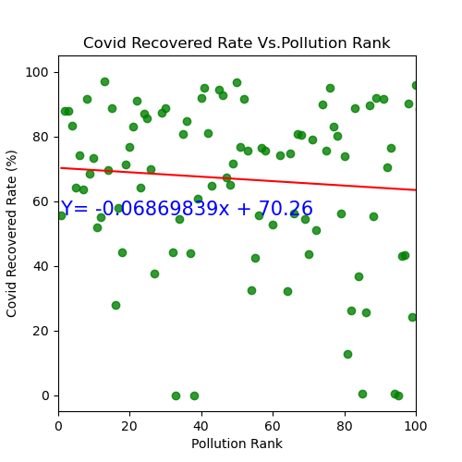
Factor: Air Quality
Hypothesis: Areas with poor air quality have shown higher rates of COVID-19 cases.
Outcome:
We performed a linear regression analyses separately for Air pollution ranks vs. confirmed Covid-19 rate; Covid19 death rates; and covid 19 recovery rates:
Air Pollution Rank vs. Confirmed Covid 19 Case Rate:
There is a weak negative correlation between the confirmed COVID-19 case rate and pollution rank. The R-value is negative (-0.130), the slope is (-0.0021127). It means that higher pollution ranks are associated with slightly lower confirmed COVID-19 case rates.
Air Pollution Rank vs. Covid 19 Death Rate:
there is a weak positive correlation between COVID-19 death rate and pollution rank, as the R-value is positive (0.266), the slope is (0.02729755). It means that higher pollution ranks are associated with slightly higher COVID-19 death rates.
Air Pollution Rank vs. Covid 19 Recovered Rate:
there is also a weak negative correlation between COVID-19 recovery rate and pollution rank, as the R-value is negative (-0.086), the slope is (-0.06869839). It means that higher pollution ranks are associated with slightly lower COVID-19 recovery rates.

Slide 8
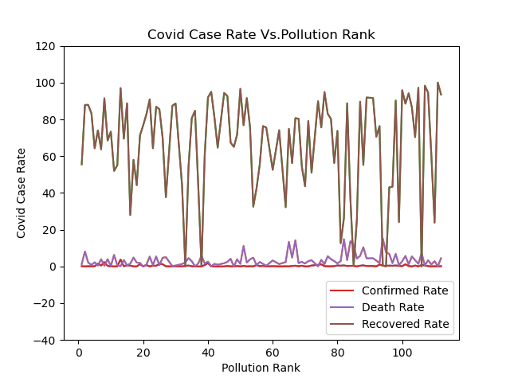
Factor: Air Quality
Hypothesis: Areas with poor air quality have shown higher rates of COVID-19 cases.
Outcome:
We also performed a line graph to analyse the relationship between Air pollution and Covid19
Based on the line graph, air pollution doesn’t have a significant effect on Covid case rates..

